Slide 1

Rumor source localization in social networks based on infection potential energy
By:-
Deobrat Kumar Jha 242IT008
Mitesh Kumar Mandal 242IT020

Slide 2

INTRODUCTION
What is Rumor Source Localization?
Identifying the origin of a rumor in a social network.
Critical for misinformation control (e.g., fake news, social media rumors).
Challenges in Existing Methods
Assumes uniform rumor spread (not realistic).
Does not consider infection delays.

Slide 3

DATASET USED
Dolphins:-
Number of vertices: 62
Number of edges: 159
Average Degree: 5.13
Average Length of shortest path: 3.36
Average Clustering coefficient: 0.259
We have also tested with below datasets:-
Facebook
ca-netscience
celegans_metabolic

Slide 4
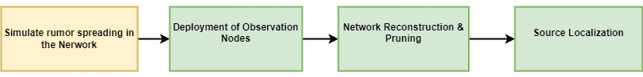
METHODOLOGY - OVERVIEW
Figure: Methodology overview

Slide 5
METHODOLOGY - EXISTING STRATEGY
Deployment of observer Nodes:-
Select 1 node per community based solely on degree centrality.
Random selection.
Fixed observer count (default=5).
Source Localization
Gaussian Density Estimation.
The rumor spread is assumed to follow a shortest path tree (BFS tree) from the source.
Using a Gaussian estimator, each candidate node s is evaluated as a potential source.
Distance Centrality Estimation.

Slide 6
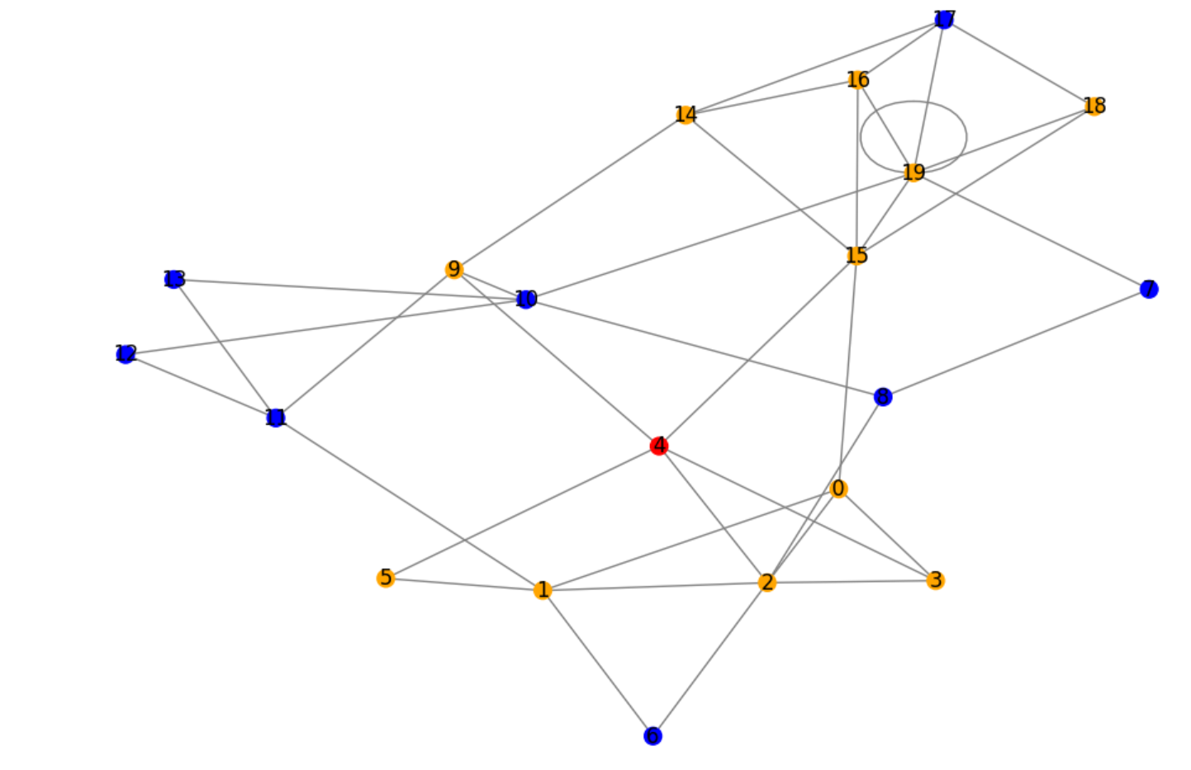
METHODOLOGY – OBSERVER DEPLOYMENT (1/2)
Figure: Rumor Propagation state

Slide 7
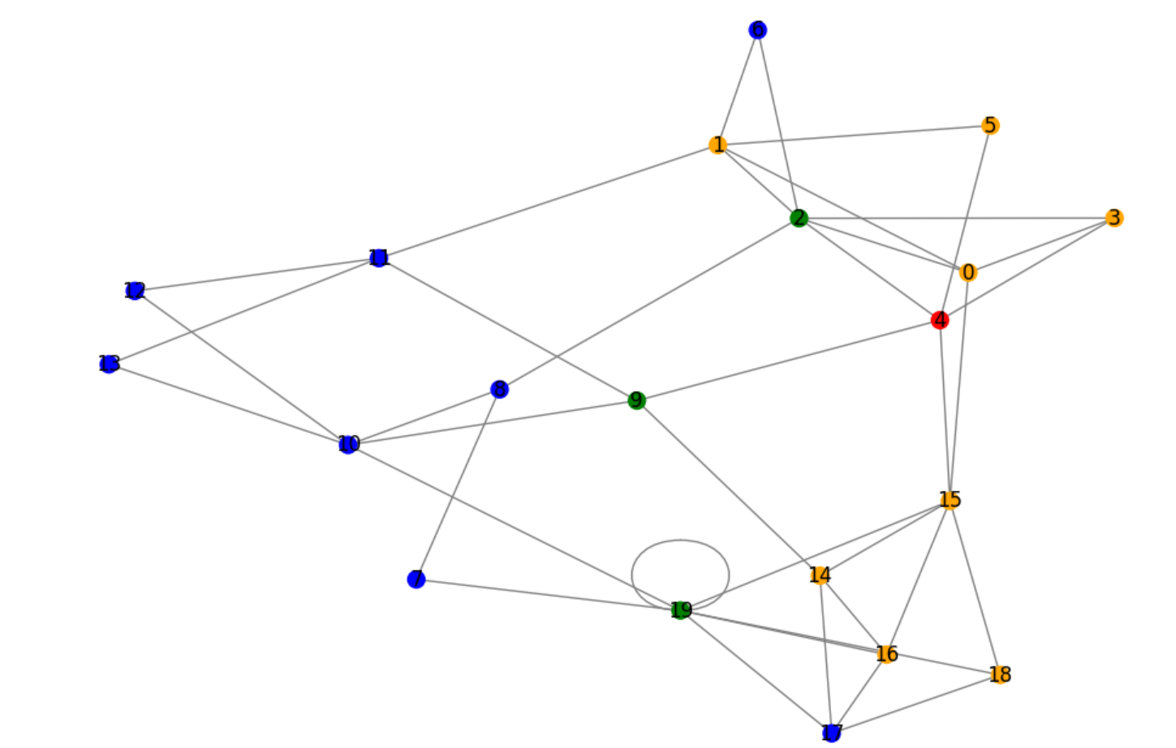
METHODOLOGY – OBSERVER DEPLOYMENT (1/2)
Figure: Observer Deployment

Slide 8
METHODOLOGY – OBSERVER DEPLOYMENT (1/2)
Our Strategy (Novelty) :-
Implemented a two-phase observer deployment with adaptive scaling.
Phase 1 - Community Core Selection :-
Selected nodes using both:
Structural importance (degree centrality).
Temporal position (earlier infection time via –propagation time).
Why Effective:
Ensures observers are both well-connected and positioned to observe propagation waves

Slide 9
METHODOLOGY - OBSERVER DEPLOYMENT (2/2)
Our Strategy (Novelty) Cont..:-
Implemented a two-phase observer deployment with adaptive scaling.
Phase 2 - Temporal Supplement :-
Adds earliest-infected nodes from largest communities.
Why Effective:
Early-infected nodes contain crucial timing clues about source proximity.
Adaptive Scaling: Observer count now scales with network size (20% nodes, max 20).

Slide 10
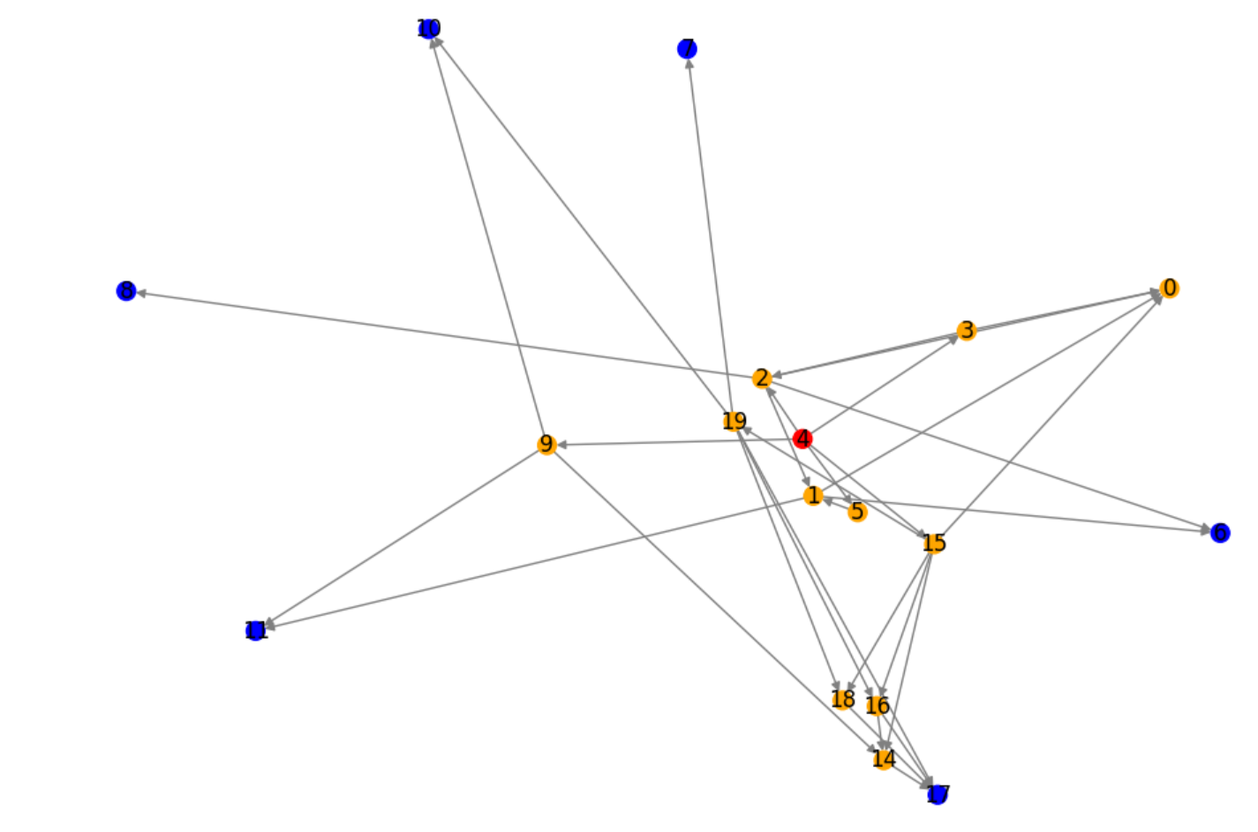
METHODOLOGY - NETWORK RECONSTRUCTION
Figure: Network Reconstruction

Slide 11
METHODOLOGY - NETWORK RECONSTRUCTION
Network Reconstruction Using Infection Potential Energy :-
The network is transformed by assigning infection potential energy to nodes.
This helps in reconstructing an accurate information diffusion path.
Here we are converting the undirected network to directed network.

Slide 12
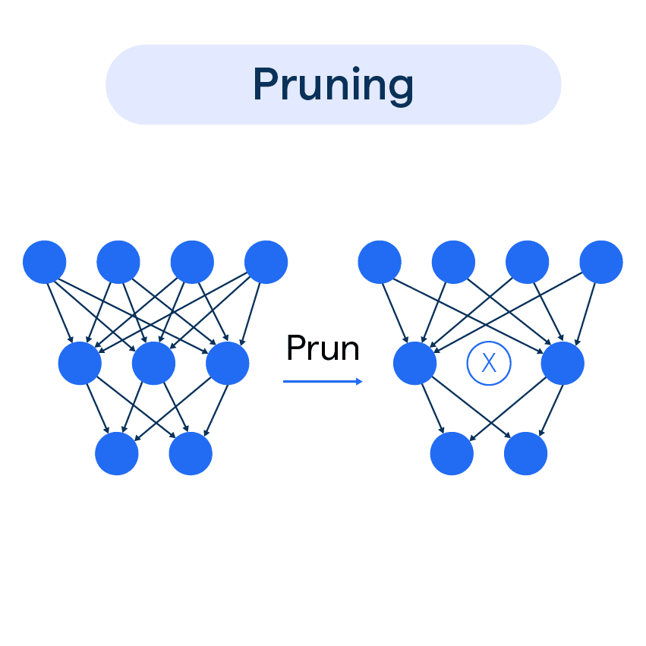
METHODOLOGY - NETWORK PRUNING
Network Pruning Based on Delay Distribution :-
Nodes that cannot be the rumor source are eliminated.
A Gaussian delay model estimates how long a rumor takes to spread, reducing the search space.

Slide 13
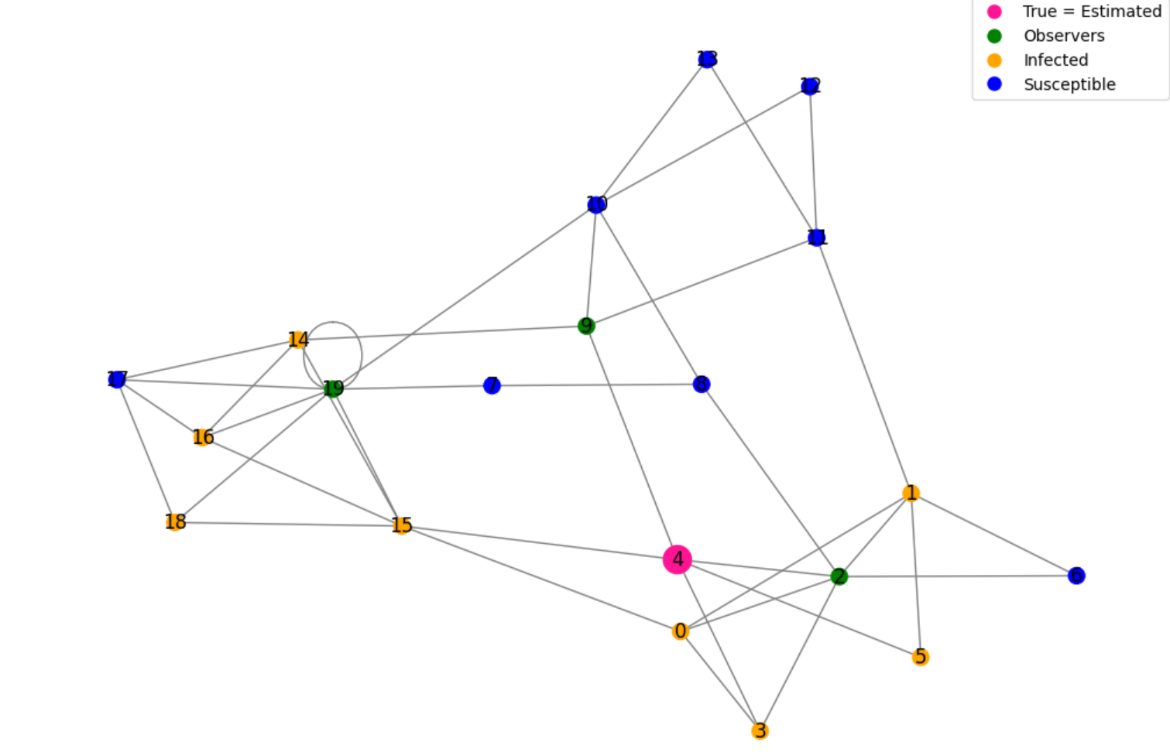
METHODOLOGY - SOURCE LOCALIZATION (1/3)
Figure: Source localization

Slide 14
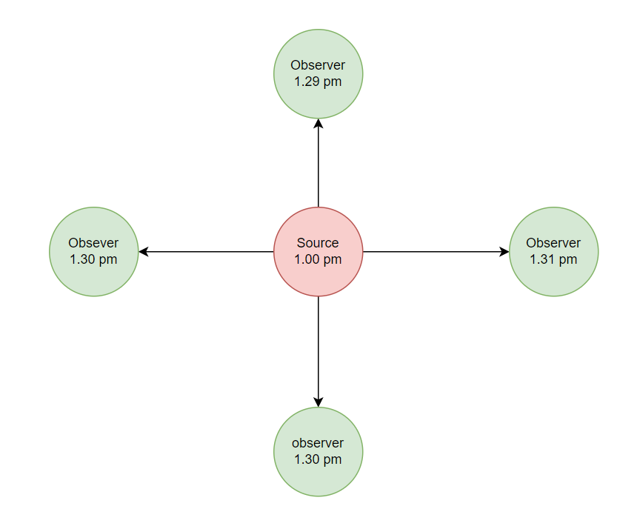
METHODOLOGY - SOURCE LOCALIZATION (1/3)
We have used Hybrid scoring system combining (Novelty):
Temporal likelihood
Structural centrality
Temporal penalty
1. Temporal Likelihood
Measures how well a candidate's infection time aligns with observer times.
Uses a Gaussian distribution centered at 0 (ideal: observers infected after candidate).
Captures statistical consistency in timing patterns.

Slide 15
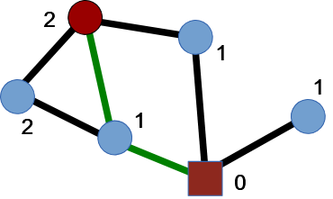
METHODOLOGY - SOURCE LOCALIZATION (2/3)
We have used Hybrid scoring system combining (Novelty):
Temporal likelihood
Structural centrality
Temporal penalty
2. Structural Centrality
Evaluates a candidate's position in the network.
Uses closeness centrality (average shortest path to all other nodes).
Sources often reside in central network positions.

Slide 16
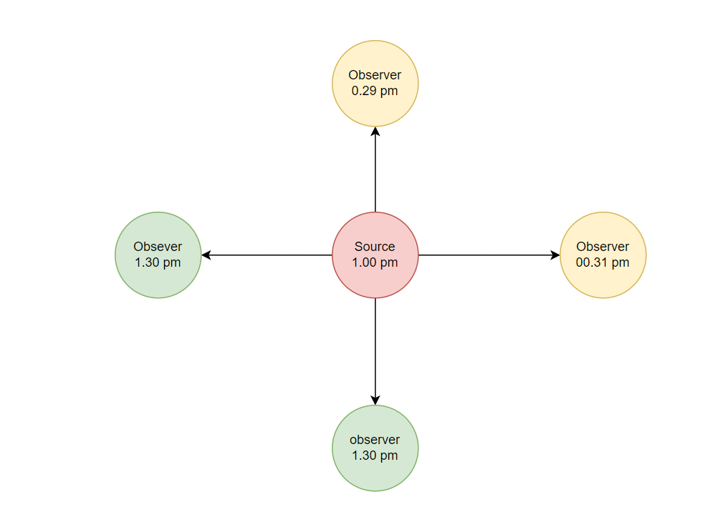
METHODOLOGY - SOURCE LOCALIZATION (3/3)
3. Temporal Penalty
Enforces logical consistency in infection timing.
Penalizes candidates with observers infected before them.
Eliminates impossible candidates violating causality.
Final Score:-
scores[node] = (temporal_score * 0.6 + centrality * 0.4 -
inconsistency_penalty)

Slide 17
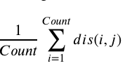
MEASURES
Accuracy = Count_correct(trues source = detected source) / Total Count
Average Error Distance =
Error Hops = It indicates the number of hops between the source node located by the algorithm and the actual source node.

Slide 18
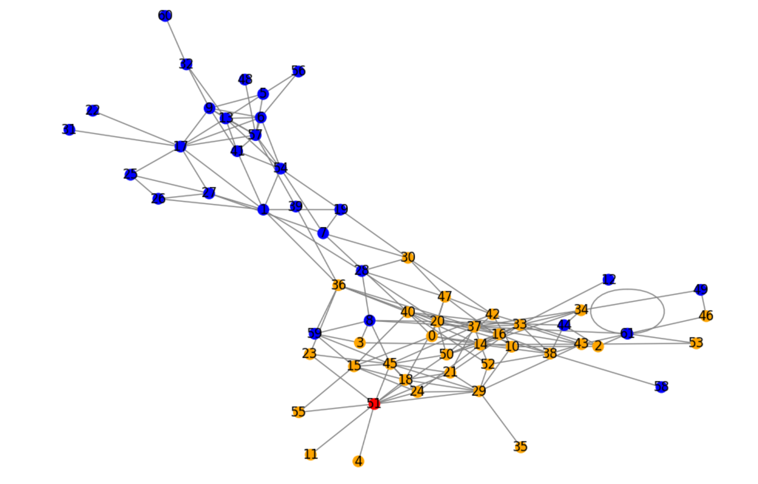
RESULT - DOLPHINS (1/7)
Figure: Rumour Propagation state

Slide 19
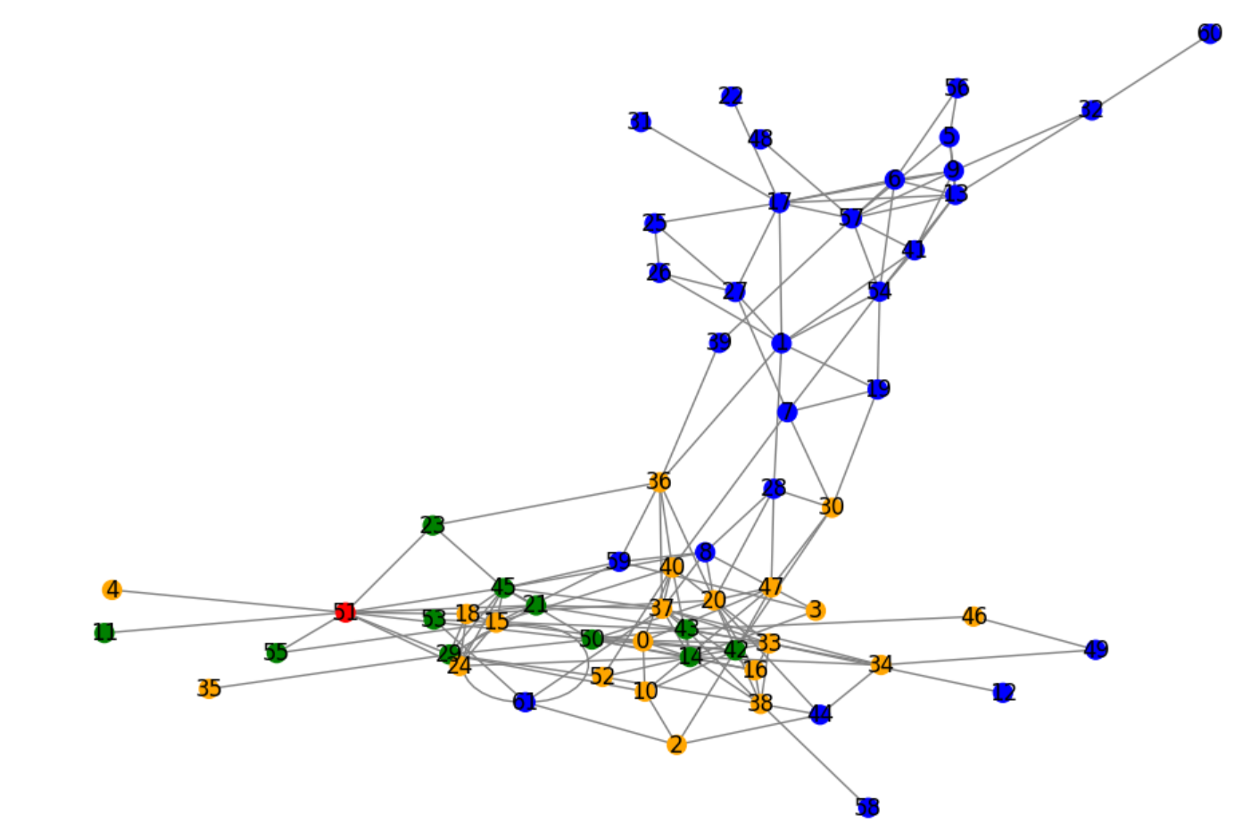
RESULT - DOLPHINS (2/7)
RESULT
Figure: Observer Deployment

Slide 20
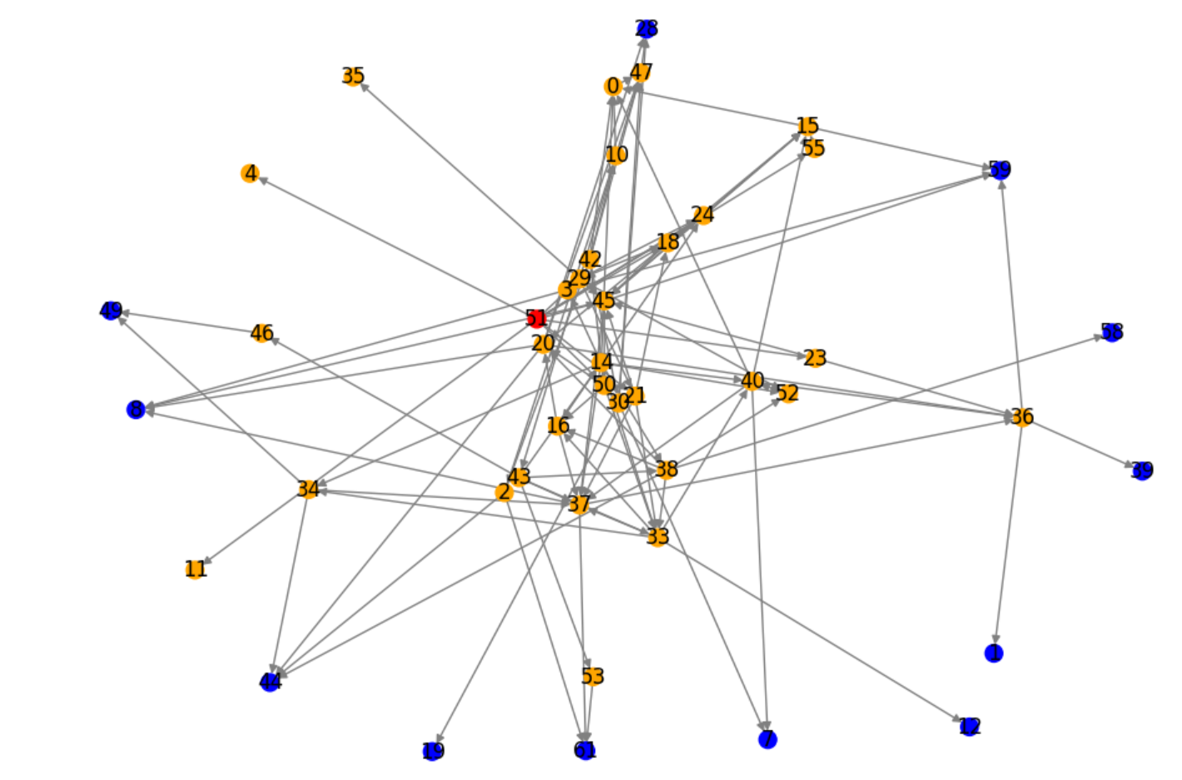
RESULT - DOLPHINS (3/7)
Figure : Reconstructed Diffusion Network

Slide 21
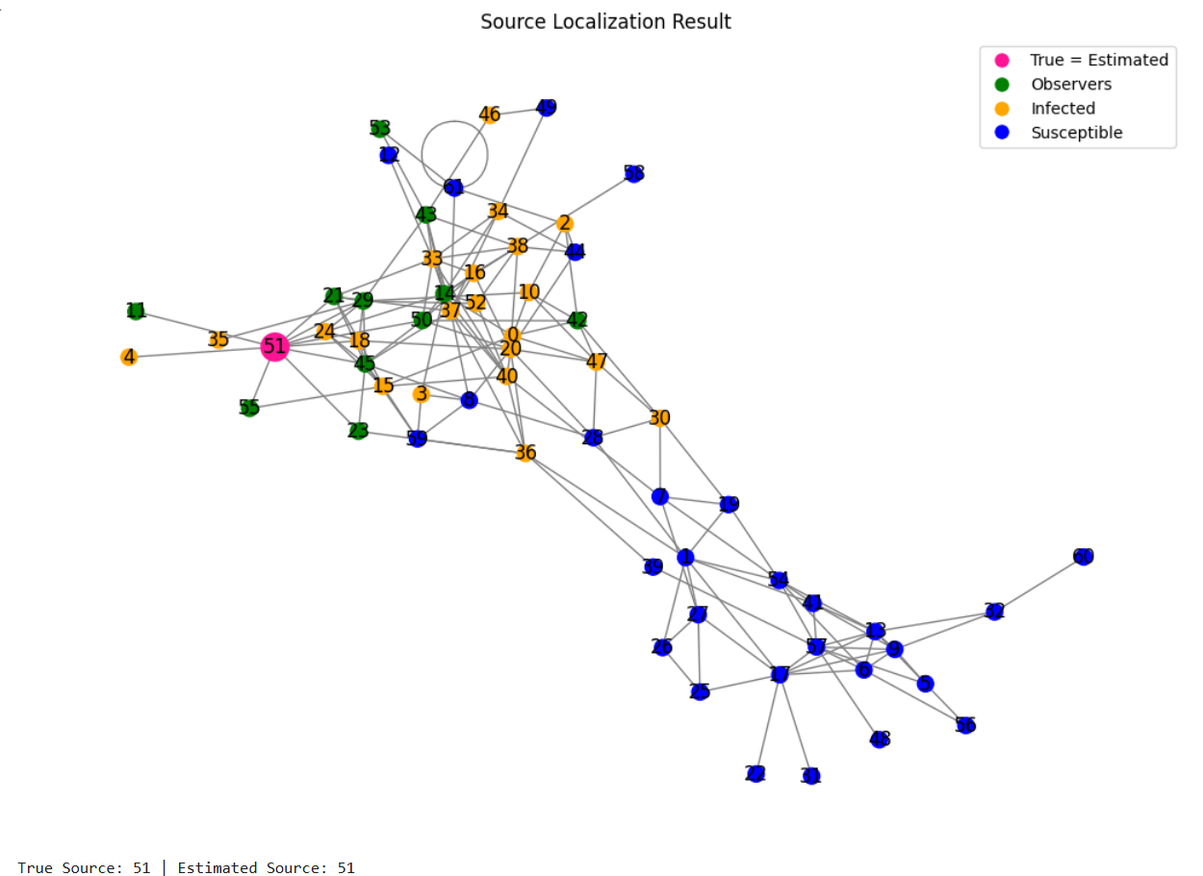
RESULT - DOLPHINS (4/7)
Figure: Source Localization

Slide 22
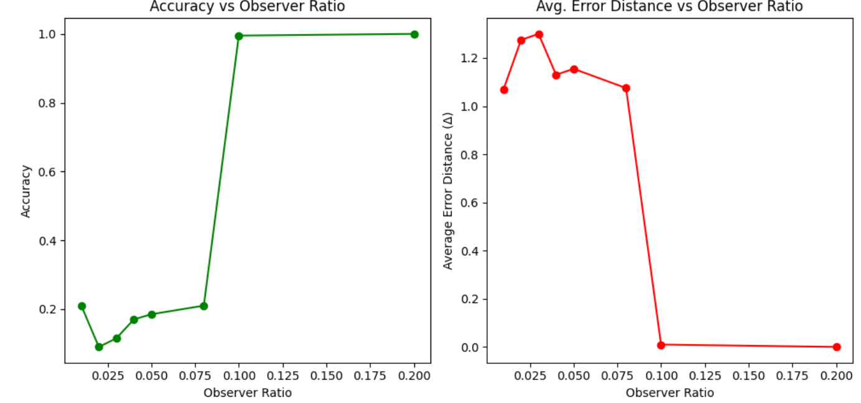
RESULT- DOLPHINS (5/7)

Slide 23
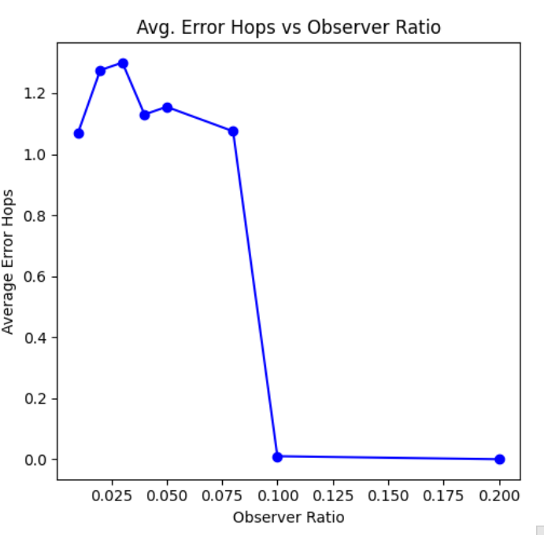
RESULT - DOLPHINS (6/7)

Slide 24
RESULT - DOLPHINS (7/7)
Table 1: Result for Dolphin Dataset on 200 Iterations
Observer Ratio | Accuracy | Avg Error distance | Average Error Hops
0.01 | 0.2100 | 1.0700 | 1.0700
0.02 | 0.0900 | 1.2750 | 1.2750
0.03 | 0.1150 | 1.3000 | 1.3000
0.04 | 0.1700 | 1.1300 | 1.1300
0.05 | 0.1850 | 1.1550 | 1.1550
0.08 | 0.2100 | 1.0750 | 1.0750
0.1 | 0.9950 | 1.0100 | 0.0100
0.2 | 1.0000 | 0.0000 | 0.0000

Slide 25
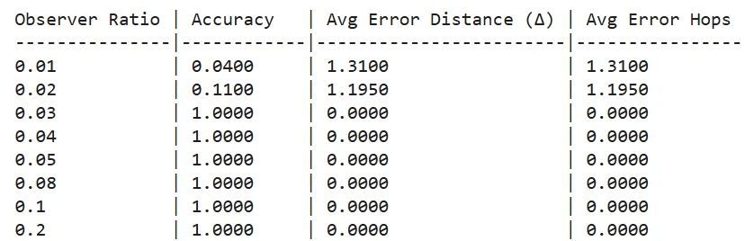
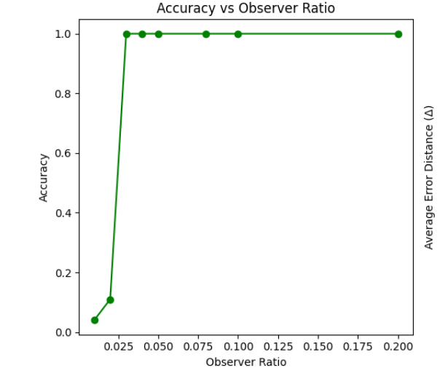
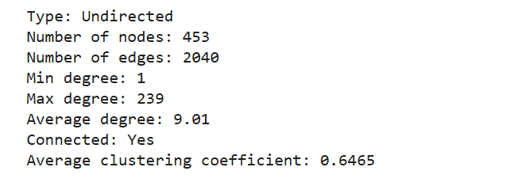
RESULT – Celegans Metabolic (7/7)

Slide 26
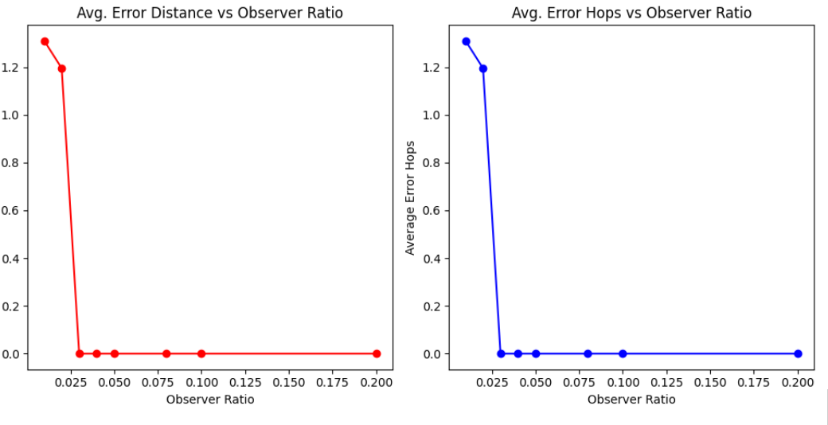
RESULT – Celegans Metabolic (7/7)

Slide 27
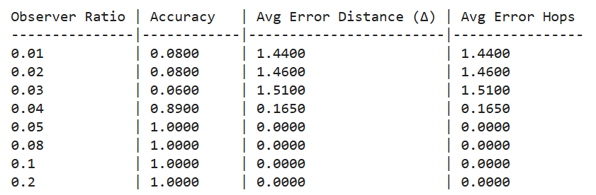
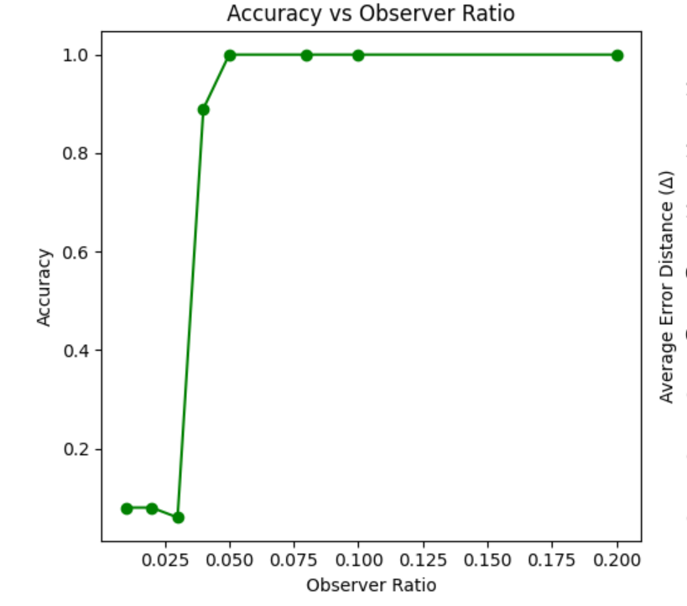
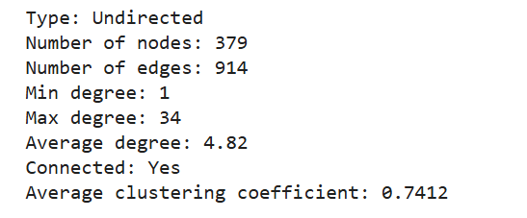
RESULT – Ca-Netscience

Slide 28
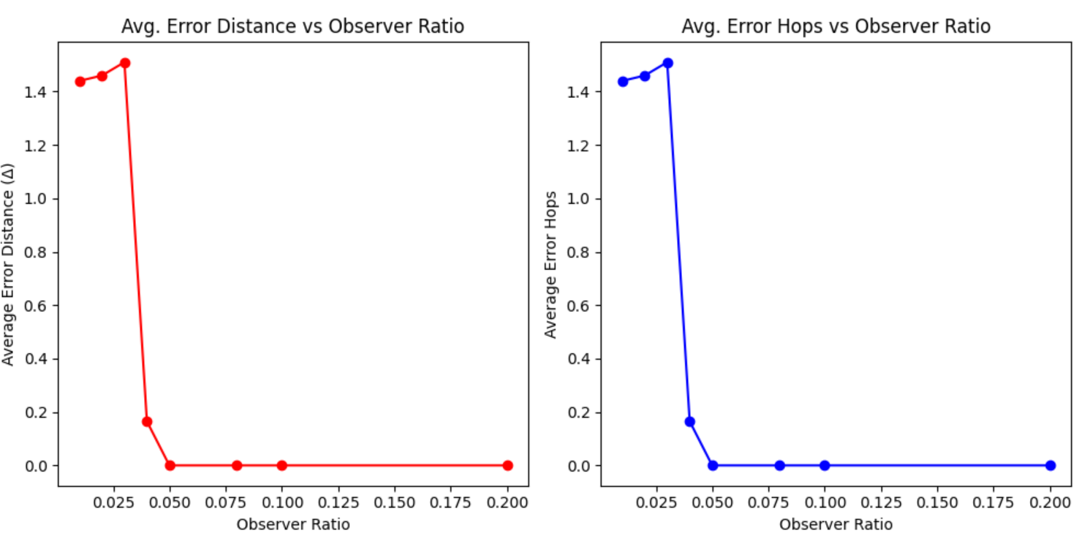
RESULT – Ca-Netscience

Slide 29
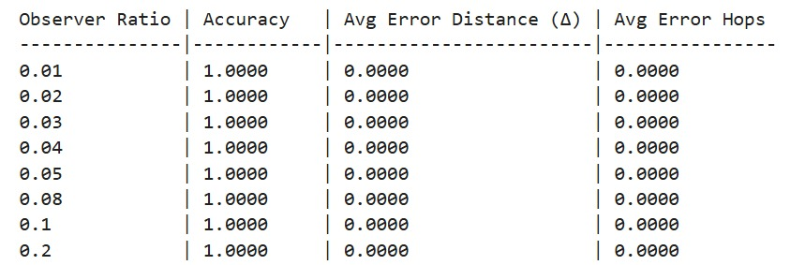
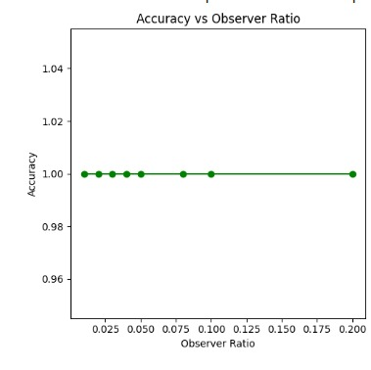
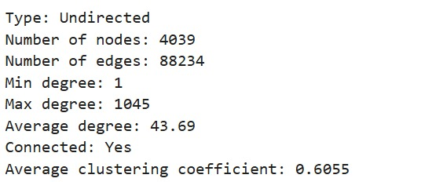
RESULT – Facebook

Slide 30
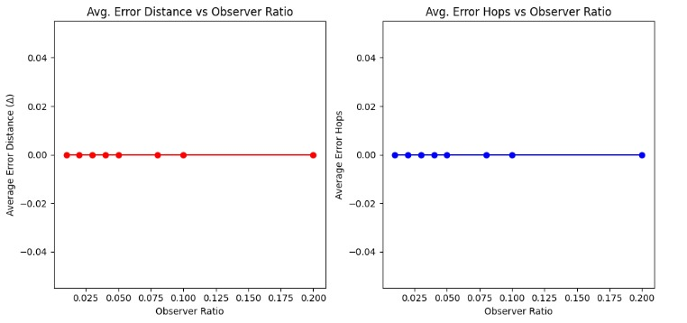
RESULT – Facebook

Slide 31

REFERENCES
Rumor source localization in social networks based on infection potential energy - ScienceDirect

